Slide 1




BeeOdiversity
Hackathon
How AI will help to
Improve our
environment
1

Slide 2
Agenda
Introduction of BeeOImpact – 10” ( Michaël)
Hackathon Objectives – 5” (Stijn)
Teaming & Organization – 15” (Stijn)
Dataset Introduction – 10” (Sven)
Data Science specific considerations – 15” (Adeline)
The price! (Michaël)
DEEP DIVE into the Data Set (Sven)

Slide 3
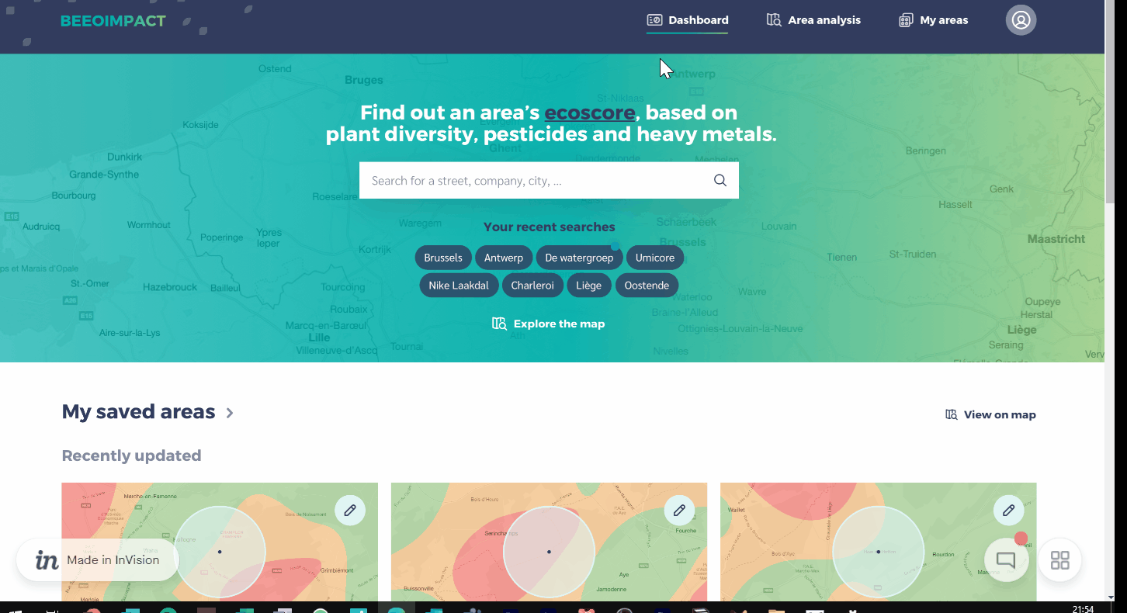
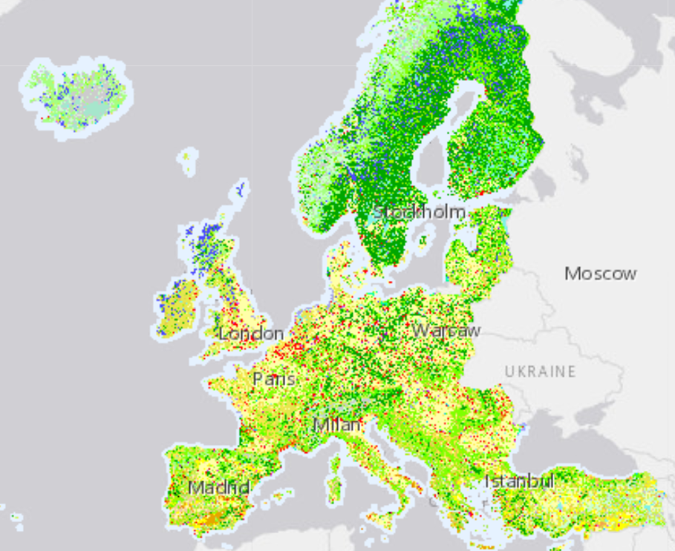



Introduction of BeeOImpact
An assessment and prioritisation of all your sites in terms of risks and improvement measures related to biodiversity and pollution.
Powered by a EU map database
Copyright © 2020 Accenture. All rights reserved.

Slide 4
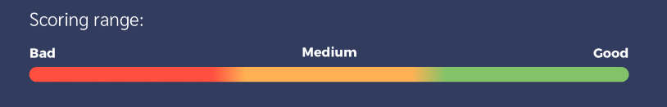
Hackathon Objectives We need to be able to calculate an “Eco Score” without having bees on site
Heavy metals
pesticides
Plant diversity
The lower the number of heavy metal contamination, the higher it scores
The lower the number of pesticides detected an area, the higher it scores
The higher the number of different plant species in an area, the higher it scores
& BEEODIVERSITY
Copyright © 2021 Accenture. All rights reserved.
4

Slide 5
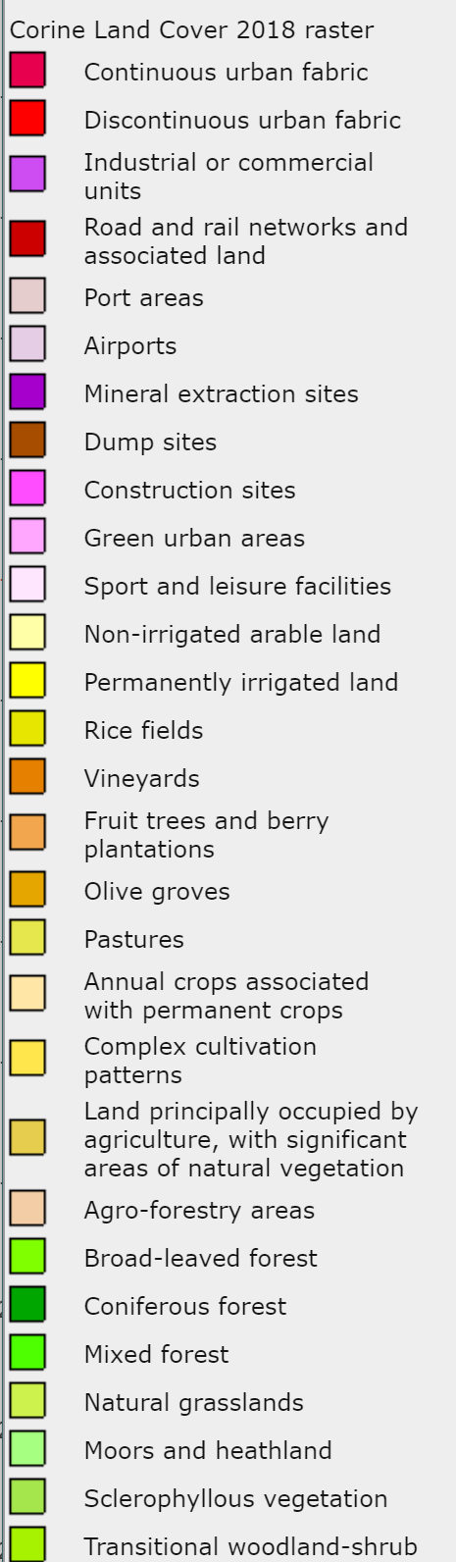
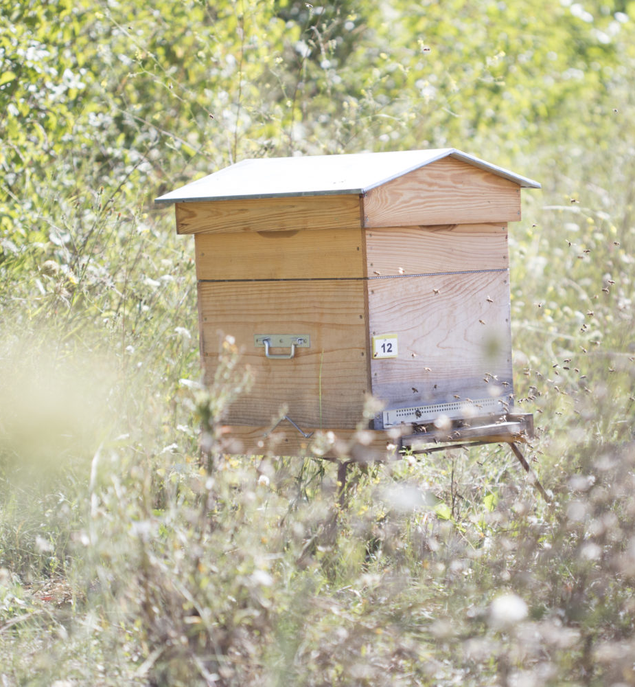
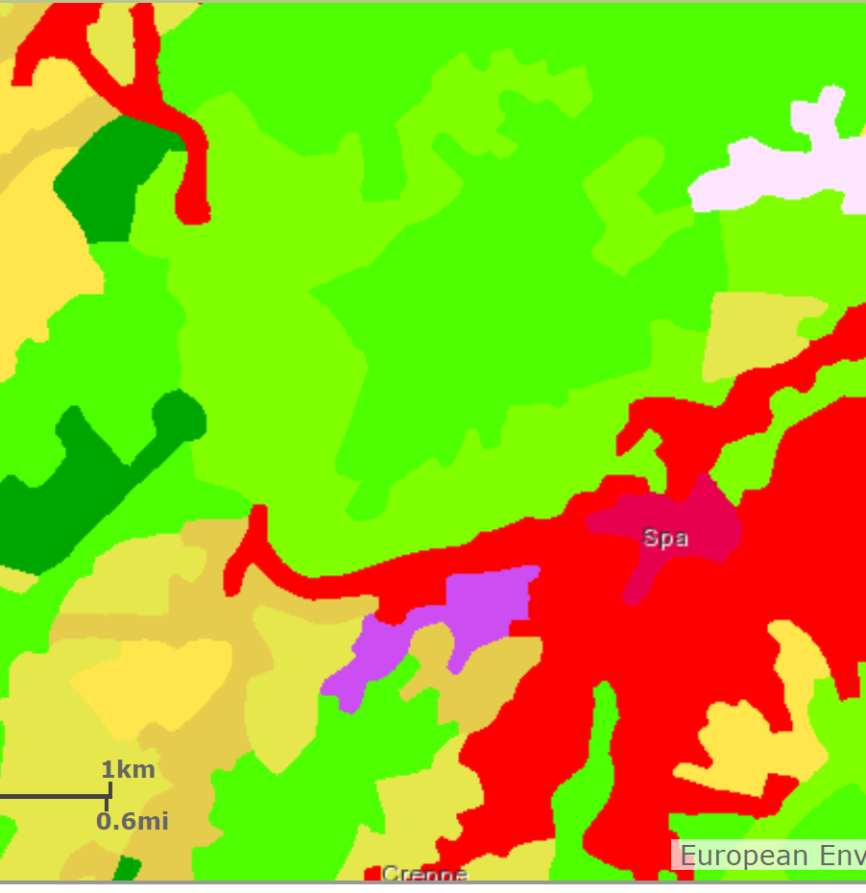
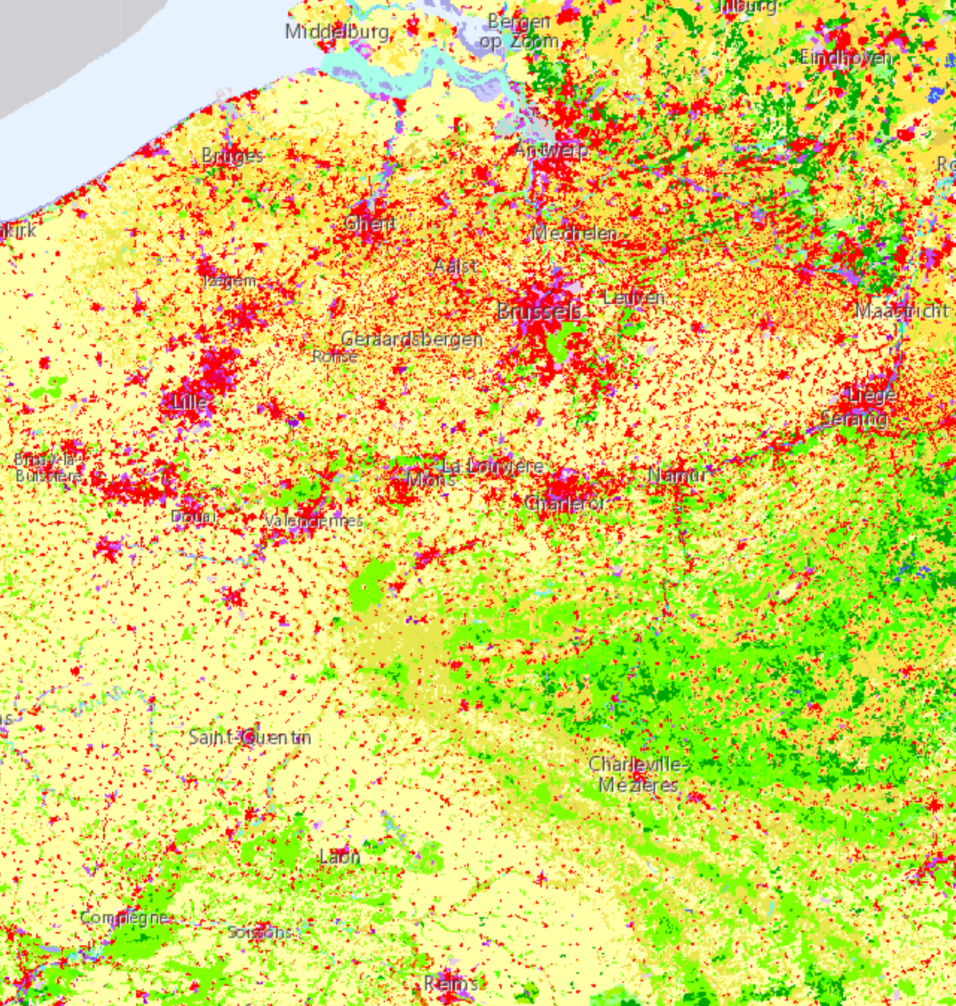
Hackathon Objectives So what Data do we have at our disposal?
Historical Data from existing BeeoDiversity clients
Map Data for existing clients
(Corine Land Cover DB)
Map Data for Belgium
(Corine Land Cover DB)
Granular legend for each land area
& BEEODIVERSITY
Copyright © 2021 Accenture. All rights reserved.
5

Slide 6
So what Data do we have at our disposal?
Copyright © 2021 Accenture. All rights reserved.
6

Slide 7
Hackathon Objectives Eco Score break down
For a new area, the eco score can be calculated for each of the 3 dimensions
Eco-score
Is computed as the worst of the three detailed scores.
Accuracy
A percentage giving the confidence in the reliability of the eco-score given.
Your focus of the Hackathon
Heavy metals
pesticides
biodiversity
Data for 7 metals
Concentration %
How many pesticides
Concentration %
How many species
& BEEODIVERSITY
Copyright © 2021 Accenture. All rights reserved.
7

Slide 8
Hackathon Objectives Basic Analytics Hypothesis - example for pesticides
Data on land cover around the new area for which estimates are required
Training of an Analytics model, estimating concentration of [Pesticides] from land cover details
Trained model estimating the concentration of Pesticides from land cover data
Historical Data on land cover* around beehives, and corresponding concentrations of [Pesticides]
*Land covers are aggregated from Level 3 of Corine Land Cover, depending on what types are expected to have an impact on heavy metals
Expected Hackathon outcome
Estimated concentration for the new area with a lot of pesticides or not.
& BEEODIVERSITY
Copyright © 2021 Accenture. All rights reserved.
8

Slide 9
Teaming & Organization Teaming Setup – Four mixed teams for this week
Team 1
Team 2
Team 3
Team 4
Ousmane Diop
Claire Perfetti
Prasamsha Sharma
Imad Haj Rashid
Jérôme Coumont
Andreas Margraff
Pierre Wasilewski
Guillaume Gémis
Ebubekir Kocadag
Guillaume Leurquin
Lise Amen
Thomas De Cleen
Jonathan Decleire
Mathieu Leers
Morgane Demesmaeker
We are ok with the teams ?
Coaches
sven.hanoteaux@beeodiversity.com
kim.nguyen@beeodiversity.com
adeline.decuyper@accenture.com
& BEEODIVERSITY
Copyright © 2021 Accenture. All rights reserved.
9

Slide 10
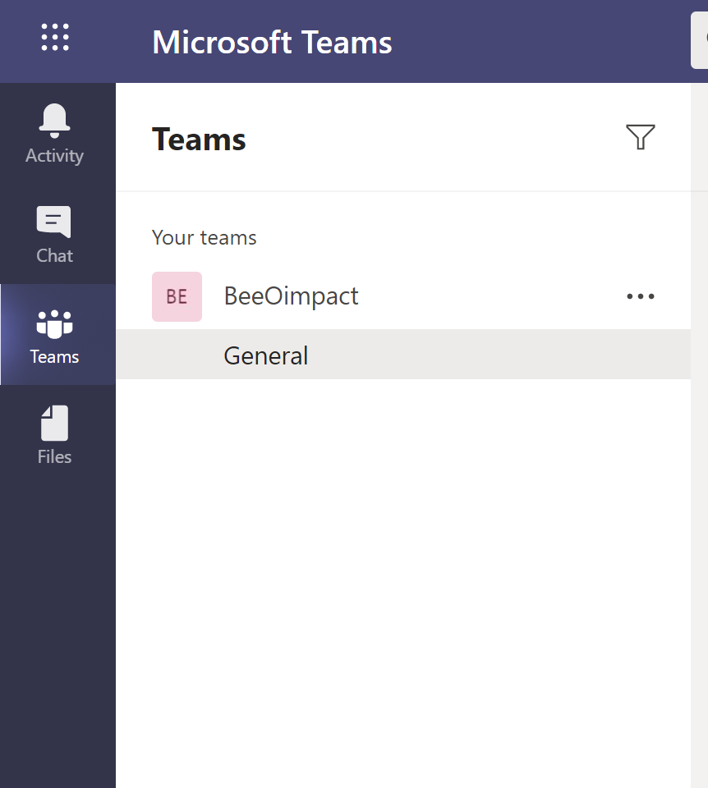
Teaming & Organization Demo moment & intermediate checkpoint & how to communicate
Mon 8 Feb
Tue 9 Feb
Wed 10 Feb
Thu 11 Feb
Fri 12 Feb
Kick-off
1PM to 3 PM- Intermediate Demo
3PM to 5PM – Final demo + award
General Channel: Contains Data files and Documentation and this presentation
Support: Channels where you can ask questions throughout the week.
Team 1 to 4: Use these channels for your teams' conversations and documents
Your deadline ;-)
& BEEODIVERSITY
Copyright © 2021 Accenture. All rights reserved.
10

Slide 11
Teaming & Organization What software & cloud can you use?
You are free to use any of your software Local or Cloud.
Leverage the skills in your team.
& BEEODIVERSITY
Copyright © 2021 Accenture. All rights reserved.
11

Slide 12

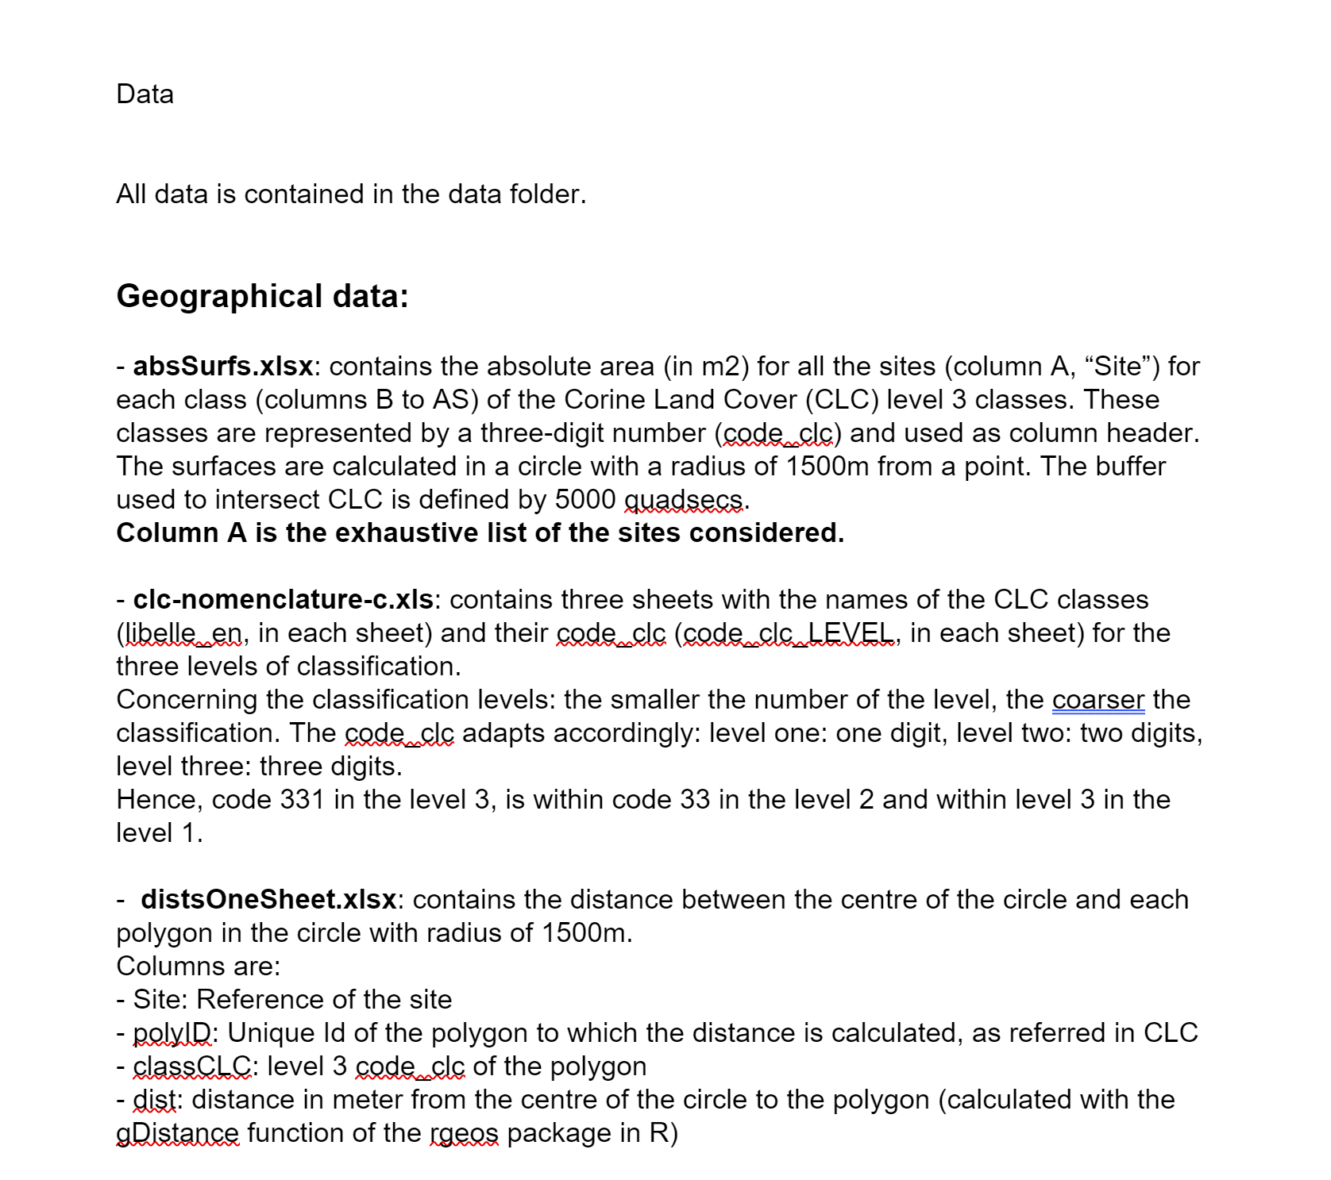
Data Set Introduction
Geographical data
Historical Data
Don’t worry, not need for GIS data structures, the work is prepared for you! :-)
All the details (attributes information) are stored on DataDescription.docx!
absSurfs.xlsx: size of the area in m² of the corine land database related to the behive site
clc-nomenclature-c.xls : legend information of the corine land database
distsOneSheet.xlsx: distance of the area to the beehive site
Heavy Metals
Pesticides
LMR.txt (Stored per year) heavy metals concentration of the beeHives existing sites
pesticides.xlsx information about each pesticide
& BEEODIVERSITY
Copyright © 2021 Accenture. All rights reserved.
12

Slide 13
Heavy Metals & Pesticides
Pesticides (115 total pesticides)
Fungicide
# xx Fungicides
Each with a threshold
Insecticide
# xx Insecticide
Herbicide
#
> Level 1
> Level 2
> Level 3
& BEEODIVERSITY
Copyright © 2021 Accenture. All rights reserved.
13

Slide 14
Data Science modeling considerations (1/2)
Choose carefully what you want to predict
Probability to have :
At least one Pesticide
At least one Fungicide (Is it present or absent)
At least one Insecticide
At least one Herbicide
At least one Pesticide above the Maximum Residual Level (MRL)
At least one fungicide concentration above the MRL
At least one insecticide above the MRL
At least one herbicide above the MRL
At heavy metal
At one of the historical measurements of Pb (lead) concentration above the MRL
At one of the historical measurements of Cd (cadmium) concentration above the MRL
At one of the historical measurements of Cu (coper ) above the MRL
Is Hg (mercury) Absence or Present ?
& BEEODIVERSITY
Copyright © 2021 Accenture. All rights reserved.
14

Slide 15
Data Science modeling considerations (2/2)
Data volume is limited and poses specific challenges
Based on the business and experiences so far, the input data should be quite good in driving your predictions.
Still, think about specific methods (such as cross validation) to improve validity score
Can accuracy can be improved when categorizing the various attributes?
Corine Land Mine categories are granular, although grouping at higher granularity may lose accuracy
Grouping all the pesticides in 3 categories (herbicides, funghcides, Insecticide may improve your model scores
& BEEODIVERSITY
Copyright © 2021 Accenture. All rights reserved.
15

Slide 16

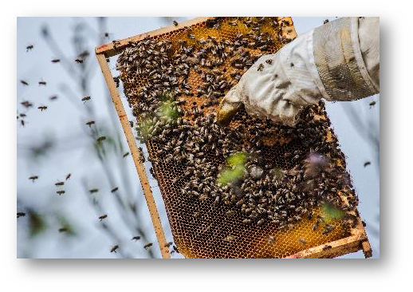
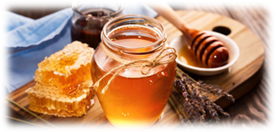
The Price ?
The winning team
Copy of the Circular Economy handbook
Beekeeping training.
2nd Prize
Box "this is more than honey"
Every participant
Honey! ☺ / seeds
& BEEODIVERSITY
Copyright © 2021 Accenture. All rights reserved.
16

Slide 17
Deep Dive

Slide 18
Have fun!!!!
Demonstrate Data Science
can predict a strong eco-score
1

